Slide 1
No-Till
Sections 8.9 through 8.12 in Blanco and Lal were used as reference

Slide 2
Benefits of No-till for Crop Production (Table 8.3 page 203)
Prevents crusting
Reduces wind erosion and crop abrasion
Reduces scour and burial from water erosion
Reduces nutrient loss from erosion
Increases soil organic matter
Increased microbial activity
Increases nutrient cycling through residue retention
Reduces diurnal fluctuations in soil temperature
Decreases rate of evaporation from soil surface
Reduces surface soil moisture fluctuation
Reduced tillage and labor costs

Slide 3
Benefits of No-till for the Environment
Water Quality
Nutrient, and sediment loads are decreased
In regions were herbicides are used regardless of tillage they too can be decreased in runoff
Wild life habitat
Pheasant in the high plains provides an example
Carbon sequestration
Albedo (reflectivity) of the surface can be increased
MAY contribute to mitigation of climate change

Slide 4
Environmental Challenges in using No-till
Increased herbicide use
Stratification of nutrients resulting in increased risk of dissolved nutrient runoff.
Improvements in macroporosity and water infiltration can cause increased leaching
Particularly concerning in systems with subsurface drainage

Slide 5
Challenges to No-Till
Herbicide Resistance
Increased management requirements
Crop rotations must be developed
Soil compaction
Must be more selective with regard to planting conditions
For example should wait until residues are dry
“Dusting in” a crop is more challenging but can be done in no-till

Slide 6
Challenges to No-Till
Grazing No-Till
Recent studies have shown that grazing can improve microbial activity and nutrient cycling
Dual purpose no-till has been shown to be equally successful as tillage systems
Fall forage production can be lower however, weight gains are generally similar because cattle don’t bog down during wet conditions
Earlier planting may also overcome cooler soil temps
However, this must be weighted against pest pressure that can occur in early planted wheat

Slide 7
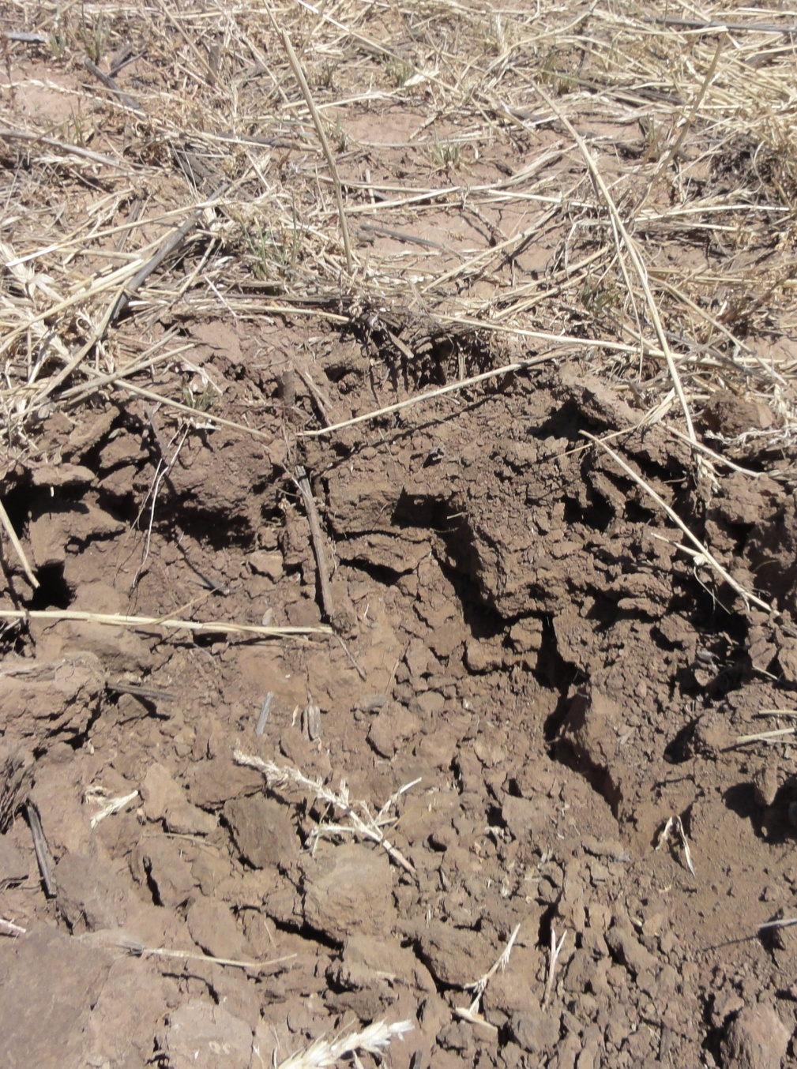
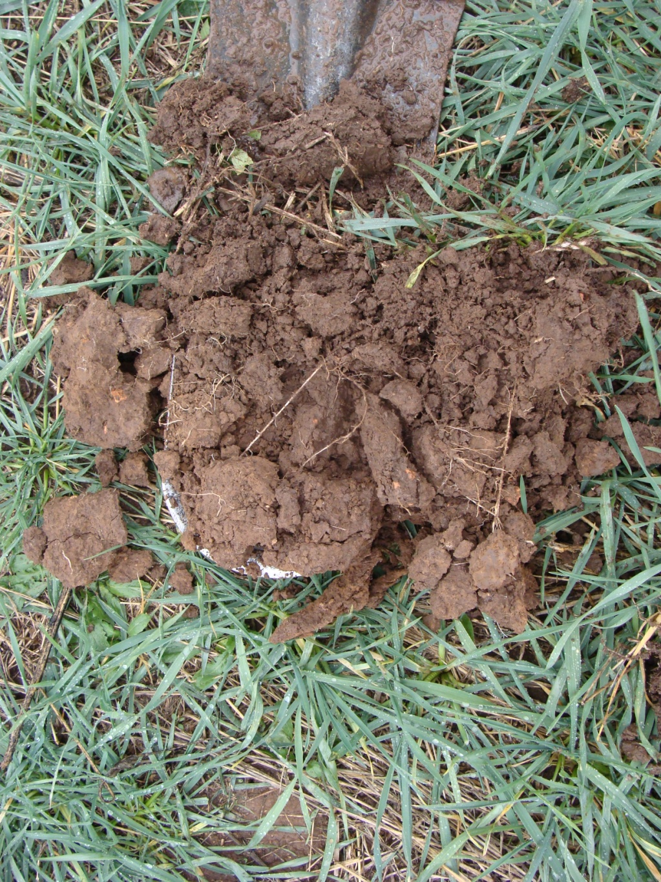
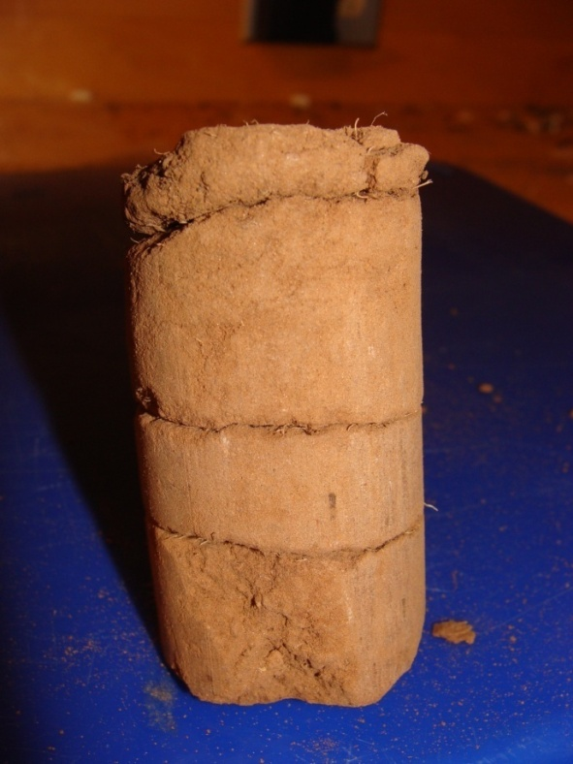
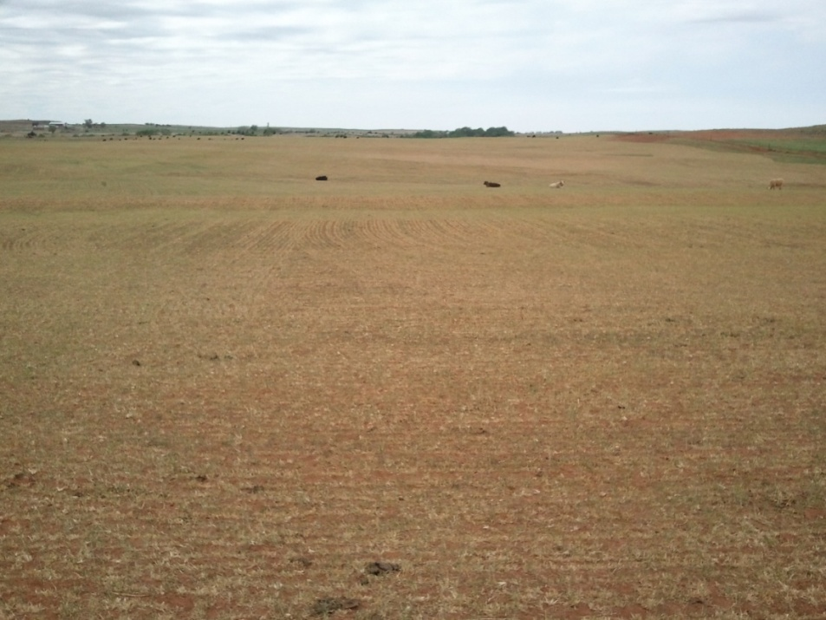
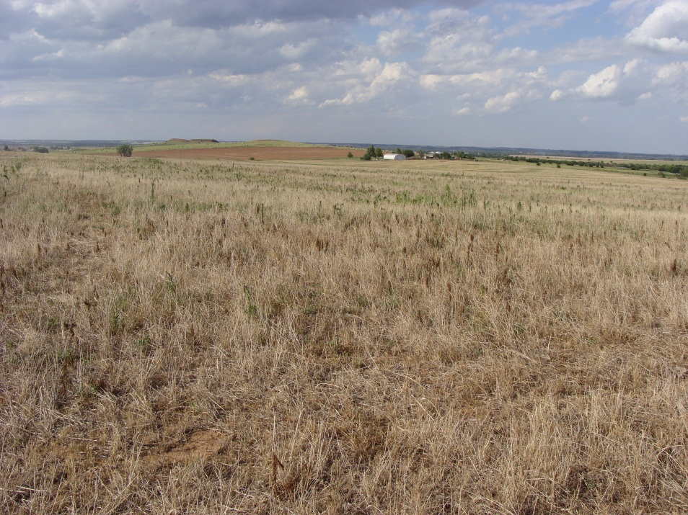
Other challenges to No-till Grazing
Must be careful not to over graze
Residue management is critical
Sufficient residue must be maintained to protect the soil surface
2 inches below the surface

Slide 8
Grazing No-till
Residue will prevent crusting and further deterioration of soil condition during fallow period
Wetting and drying cycles will alleviate compaction
Maintenance of residue or green growing plants also ensure active root growth which prevent compaction

Slide 9
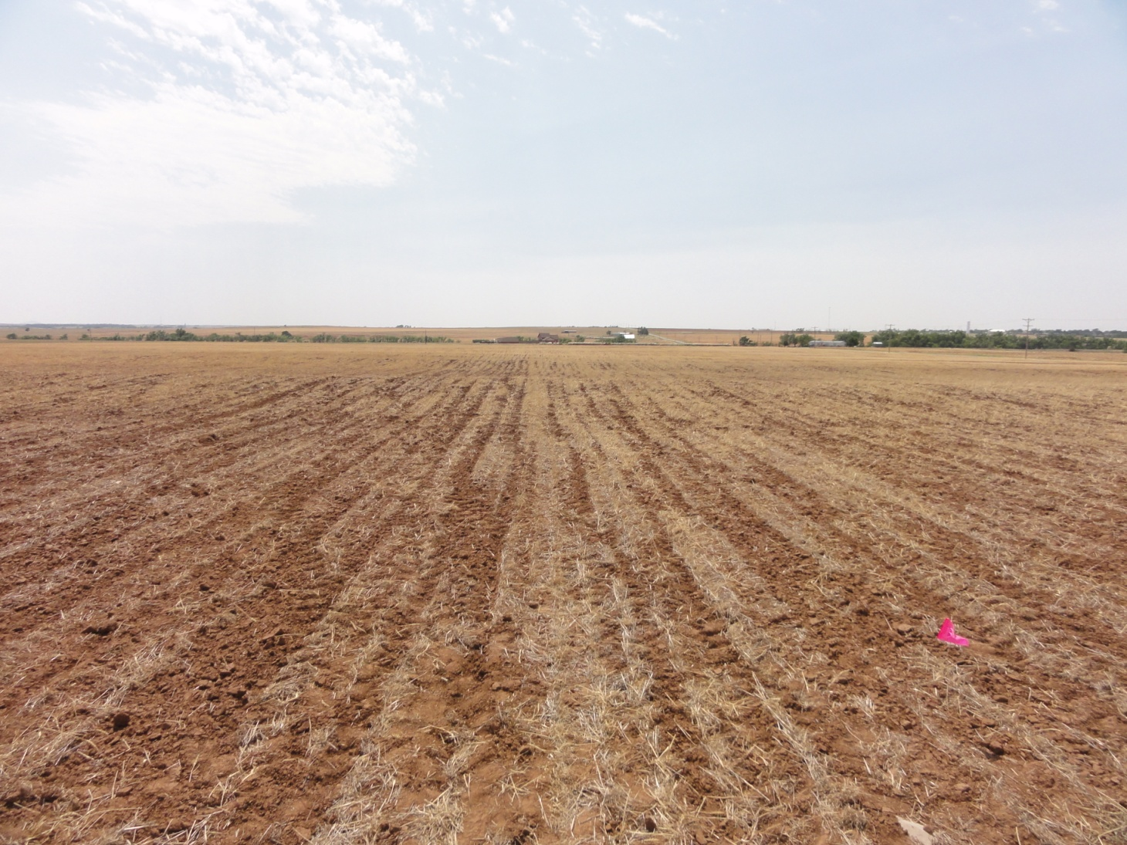
Grazing No-till
If severe compaction results from gazing deep tillage is not required
Grazing generally will only compact soil at 0-4 inches
Shallow ripping
will break up
compaction from
grazing

Slide 10
Soil Structural Improvements
Removal of tillage from the system allows soil structure to improve
Macropores formed from shrink/swell, root growth, and worm borrowing can be maintained
Surface residues are critical for maintaining this structure
Protect surface from crusting
Provide organic matter for biological activity and aggregate stability

Slide 11
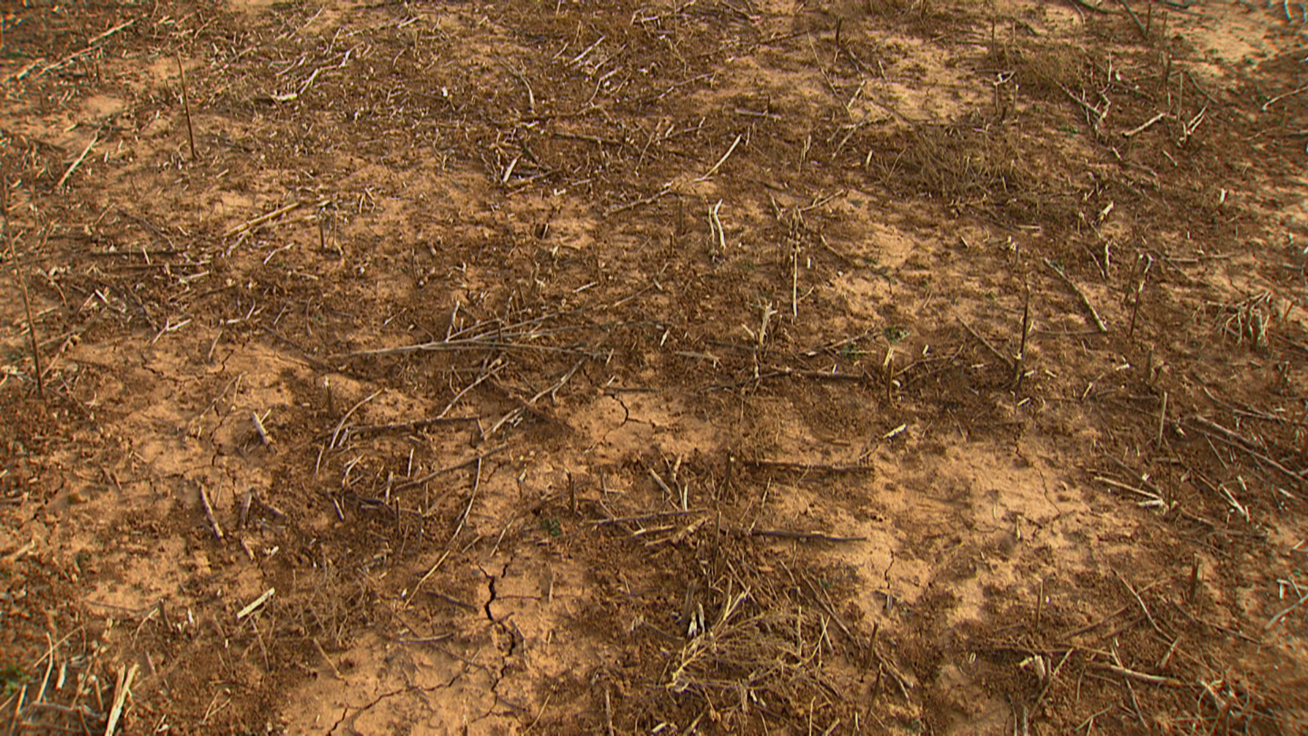
Soil Structural Improvements
Bare surface of a 15 year old no-till soil after cotton followed by sesame

Slide 12
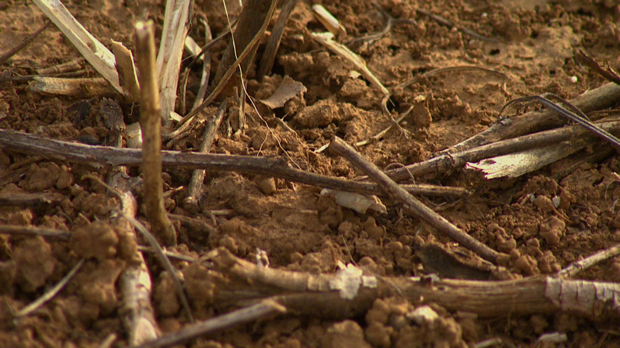
Soil Structural Improvements
Worm casts cover the soil surface

Slide 13
Soil Structural Improvements
A high residue crop is needed to protect this soil form degradation

Slide 14
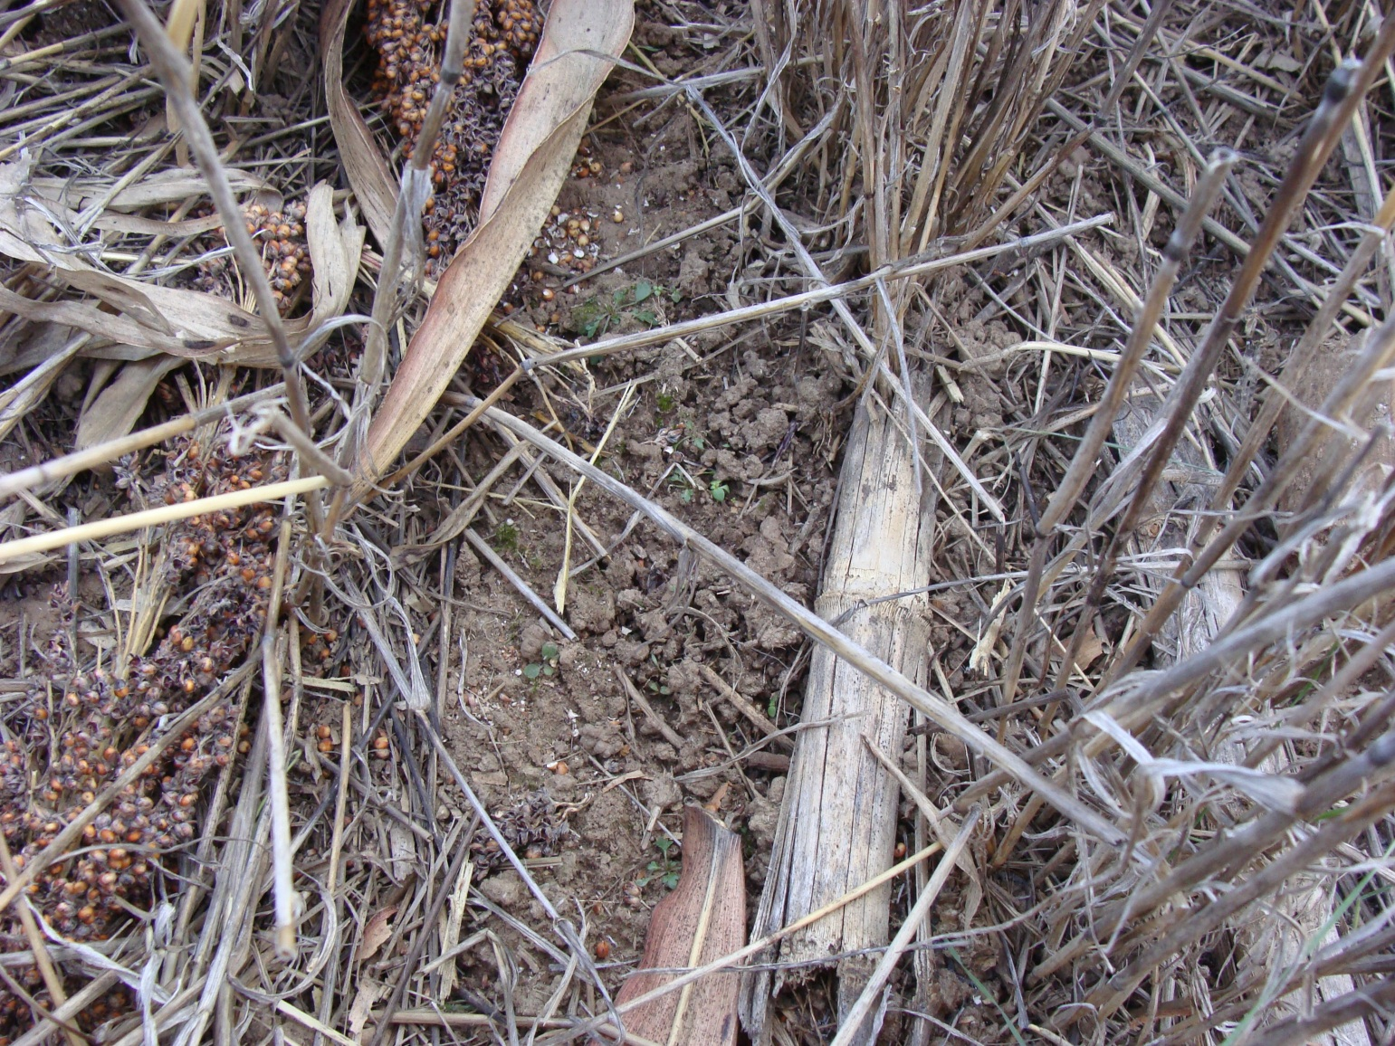
Surface Evidence of Soil Structure
Worm casts under residue

Slide 15
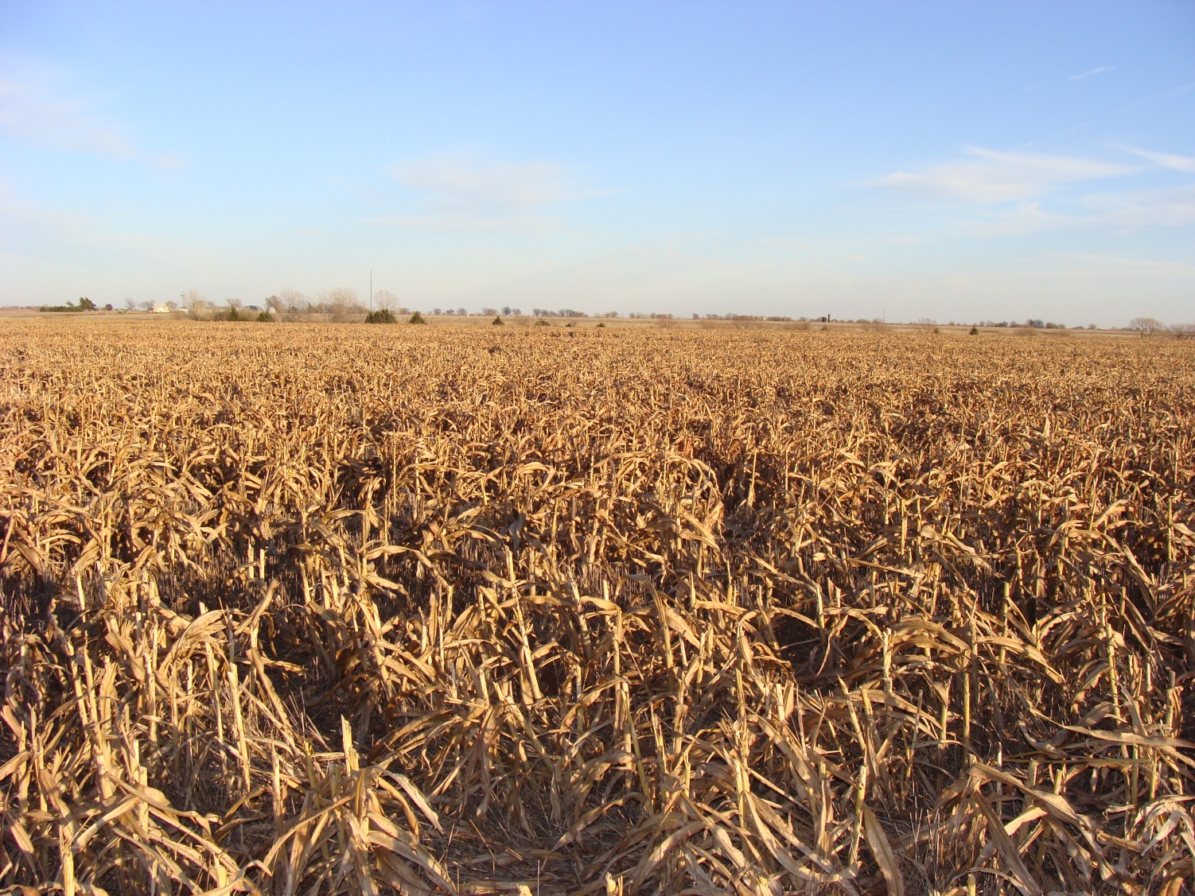
Surface Evidence of Soil Structure
70 bushel double crop sorghum after 50 bushel wheat

Slide 16
Topsoil structure
Granular or small blocky structure is preferred in surface soil
Tillage temporarily improves soil tilth (section 8.2)
Reconsolidation results in massive structure
This is why residue maintenance is so important
Prevents crusting
Cover crops in the early years of adoption may also help by providing root growth during fallow period

Slide 17
Benefits of Structure
Increased Macroporosity improves air, water and root movement in soils
As structure improves so will:
Root respiration
Water availability
Nutrient uptake
Runoff may also decrease

Slide 18
Influence of No-Till on Evaporation
Maintenance of crop residues decreases the rate of evaporation
It does not eliminate it
In environments like Oklahoma evaporation represents the largest loss of water from a summer fallow system
No-till can decrease this loss and make double crops and summer more successful

Slide 19
Soil Water in 0-15 inch Depth at Lahoma (7/09-6/11)
Surface soil moisture is generally higher in NT
Reduced Evaporative Water Loss

Slide 20
Soil Water in 4 ft Profile at Lahoma (7/09-6/11)
Effect of tillage is reduced

Slide 21
July 2009
August 2009
Oct. 2009
Nov. 2009
Dec. 2009
March 2010
April 2010
May 2010
June 2010
July 2010
August 2010
Jan. 2011
Feb. 2011
May 2011
Sept. 2009
Feb. 2010
Sept. 2010
Oct. 2010
Nov. 2010
March 2011
April 2011

Slide 22
Wheat Yields at Lahoma
Cropping System | Yield
2008 | Bu/acre
Conv. Wheat | 36
NT Wheat | 38
NT Wheat After Canola | 41
2009
Conv. Wheat | 43
NT Wheat | 44
NT Wheat After Summer Crops | 50
2010
Conv. Wheat | 37
NT Wheat | 31
NT Wheat Second Year After Summer Crops | 34
2011
CT Wheat | 64
NT Wheat | 65
NT Wheat After Canola | 74
NT Wheat After Summer Crops | 53

Slide 23
Average Yields at Lahoma
Cropping System | Yield
 | Bu/acre
CT Wheat | 45
NT Wheat | 44
NT Wheat After Canola | 57
NT Wheat After Summer Crops | 46

Slide 24
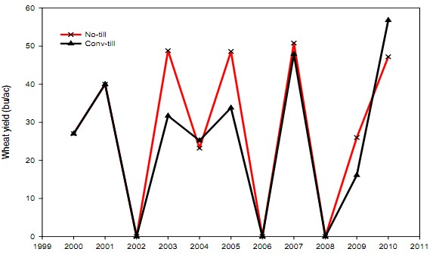
Long-Term Wheat Yields in Goodwell

Slide 25
Long-Term Sorghum Yields in Goodwell

Slide 26
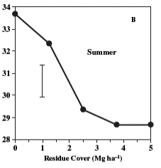
Soil Temperature under No-till
Crop residues decrease soil temperature in summer months
Can increase soil temps in winter due to insulation

Slide 27
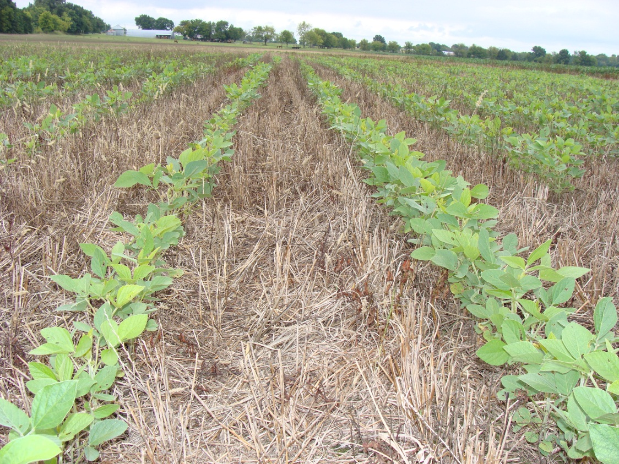
Soil Temperature under No-till
Decreased summer soil temps can benefit late spring planted crops
Soybeans
Decreased temps
can be a challenge
for early planted
crops:
corn

Slide 28
Soil Compaction
All soils managed using modern mechanical agricultural practices are compact
The extent of compaction and its impact on productivity is dependent on soil type and management
Surface compaction is of specific concern for no-till soils
Cannot be tilled away

Slide 29
Soil Compaction
Greater efforts to limit traffic during wet periods are needed in No-till
Controlled traffic becomes a more attractive management option for no-till systems
Prevents whole field compaction
Compacted traffic lanes allow for more rapid entry into field after rainfall events

Slide 30
An Example of a Controlled Traffic Program
The key is to minimize the annual foot print.
Wide traffic lanes increase the area that could be negatively impacted by traffic
The system would be best served by not utilizing duels and eliminating field activities during wet conditions.
 |  |  |  |  |  |  |  | Tractor dual Sprayer |  | Tractor |  |  |  | Tractor |  | Tractor dual Sprayer
 |  |  |  |  |  | Combine |  | Combine |  |  |  |  |  |  |  | Combine |  | Combine
 |  |  |  |  |  | dual |  | Grain Cart |  |  |  |  |  |  |  | Grain Cart |  | dual

Slide 31
An Example of a Controlled Traffic Program
Precision driving would help in row crops.
Will keep tracks in the inter-row space
Would not be as effective in the wheat crop
Tram lines would provide for precision driving in a wheat system
 |  |  |  |  |  |  |  | Tractor dual Sprayer |  | Tractor |  |  |  | Tractor |  | Tractor dual Sprayer
 |  |  |  |  |  | Combine |  | Combine |  |  |  |  |  |  |  | Combine |  | Combine
 |  |  |  |  |  | dual |  | Grain Cart |  |  |  |  |  |  |  | Grain Cart |  | dual

Slide 32
A Brief History of No-Till
The Earliest forms of No-till were adopted during the 1960 in the U.S.
No-till adoption was made possible by:
Development of Herbicides
Demonstration sites
Introduction of fluted coulter planters
However, adoption was limited to a small portion of cropland until the 1990s
30 years for a significant change in cultural practices!!!

Slide 33
No-Till Adoption
Conservation Technology Information Center, 2004
An OSU Extension Survey found that No-till practices were implemented on 28% of Oklahoma Cropland in 2008

Slide 34
No-Till in South America
South America has experienced the most impressive rate of no-till adoption
Increased from 0.7 to 40.6 Mha between 1987 to 2004
Paraguay has the larges percentage of No-till cropland in the world,
Nearly 70% of the cropland is in no-till

Slide 35
No-Till in Europe
Efforts to establish no-till were initiated in the 1950
Adoption was limited because of problems with weed control
Similar story to the U.S.
The first experience producers had were negative.
This appears to have delayed adoption even after technologies were improved

Slide 36
No-till in Africa
In general, adoption is very limited
In Africa, adoption is limited by
Cost of mechanized no-till equipment
Land tenure
Harsh climate conditions????????
Lack of knowledge
Lack of crop residues (cultural practices associated with animal production and fuel)

Slide 37
No-Till in Asia
Generally represents a small faction of total cropland management
India provides for some optimism:
No till wheat acres increased from 400 ha in 1998 to 2.2 Mha in 2005.

Slide 38
No-till in Australia
No-till is expanding rapidly
In Western Australia 85% of cropland is no-till
Nationally only 40% of cropland is under no-till

Slide 39
My thoughts on Why No-Till Adoption has been Slow
Reinvestment costs for older producers
65 year old farmers are generally not interested in borrowing money and changing their business model
Knowledge gaps must be filled
This takes time and effort
Early efforts had limited success
We have better equipment and technologies
Perception that no-till can not be grazed
It can be successfully grazed but changes are required

