Slide 1
Precision Ag and Conservation
Precision Ag Technologies are most often developed to increase efficiency and decrease input cost
However, they provide great opportunity for soil and water conservation
Technologies may be used to indirectly map soils at high resolution?

Slide 2
Yield Maps
What controls Yield???
Nutrient availability
Organic matter, clay content, and type
Plant available water holding capacity
Depth, texture, horizonation, and organic matter content
Soil aeration
Pest pressures
pH, salinity
A soil map should tell us many of these things

Slide 3
Yield Maps
Some times they can be useful
If soil mapping unit is uniform
If there are biologically (influential on yield) significant differences between mapping units in a field
Sometimes soil maps provide very little explanation of yield variability
Heterogeneous mapping units
No biologically significant differences between mapping units.
An understanding of soils and how they are mapped can be useful in interpretation

Slide 4
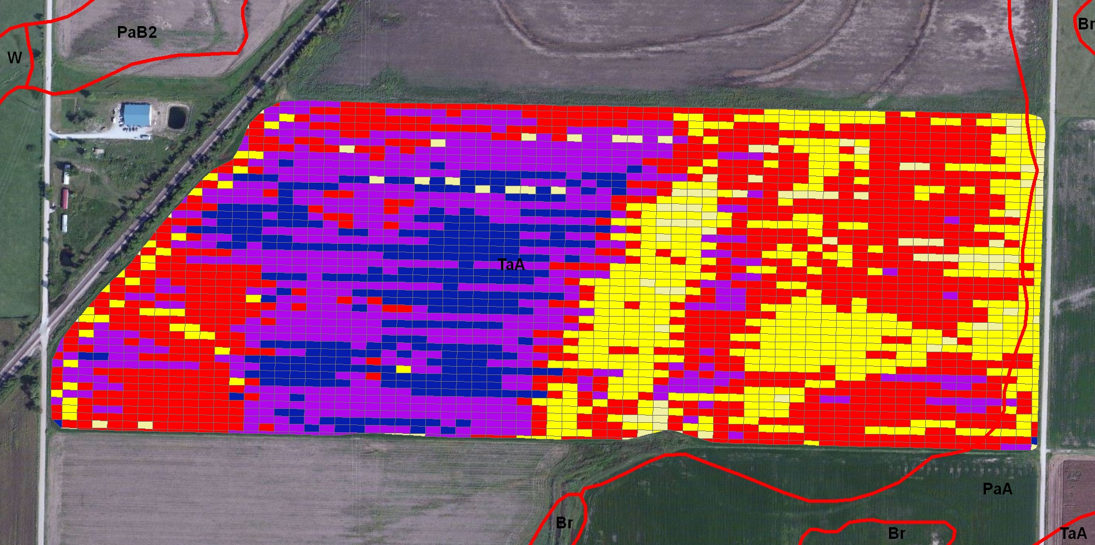
Soil Survey map
The whole field is a Taloka silt loam, which is a highly variable mapping unit

Slide 5
Range of Soil Characteristics for the Taloka
Depth to Redoximorphic features (indicator of wetness)=6-14 inches
Depth to clay pan=28-48 inches
Clay content=30-60%
Excellent example of a mapping unit that provides limited information for precision management.
Every acre can easily be different.

Slide 6
Relationship Between Limiting Layer and Yield (Ottowa Co)
Limiting layer is defined as the layer with a clay content above 35%, containing Redoximorphic features (drainage problem)
The high yielding outliers indicate that much of the field is under managed
Problems with:
Nutrients
pH
Salinity

Slide 7
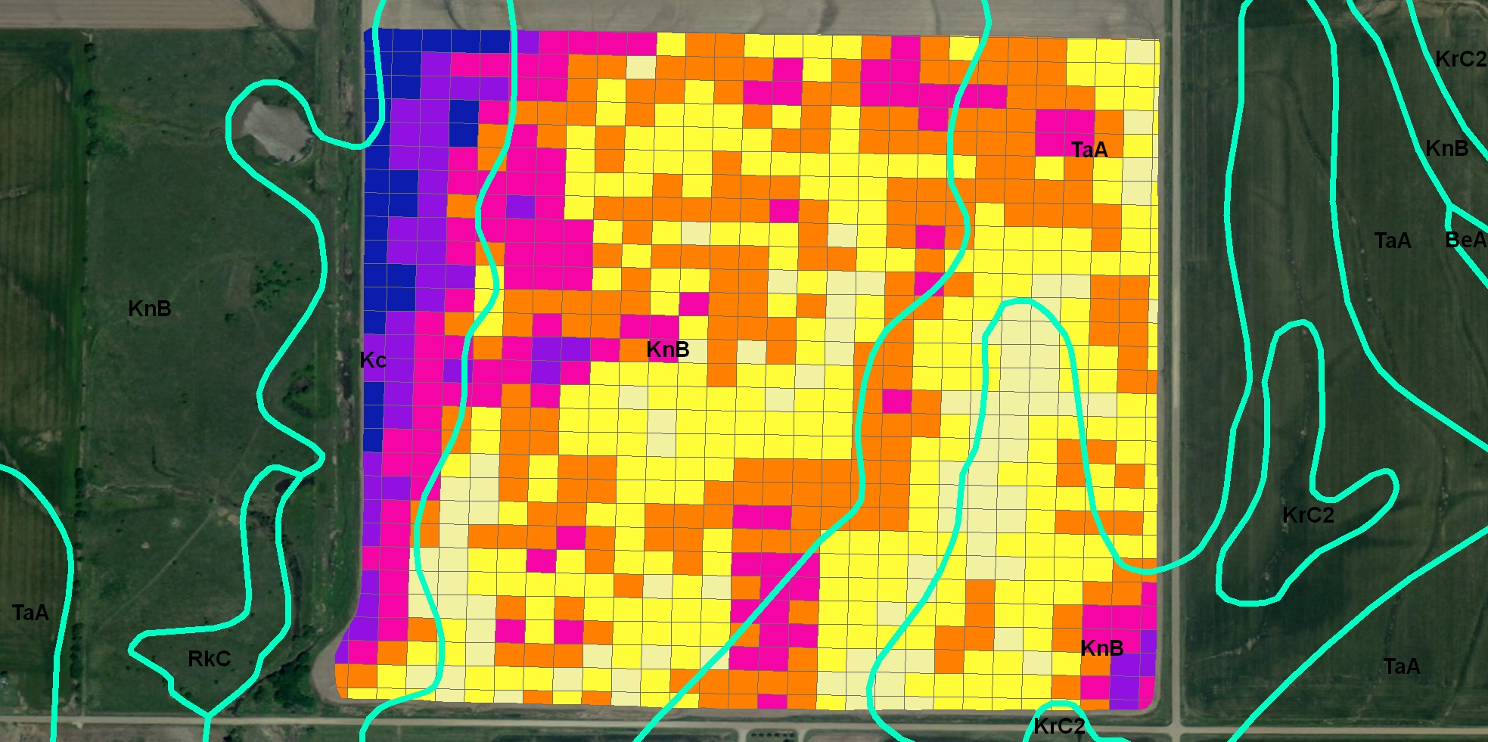
Soil Map, Ponca City
A little bit!
Port Silt loam is a beautiful Alluvial soil
The Tabler and Kirkland aren’t bad but they’re not Ports

Slide 8
Relationship Between Limiting Layer and Yield
Restrictive layer was defined as a firm layer with a clay content greater than 35%, and a color value greater than 2.
The color component accounts for the very dark brown subsoil in the Port silty clay loam
This Port did have clay
greater than 35% but
organic matter content
and landscape position
prevented yield limitation

Slide 9
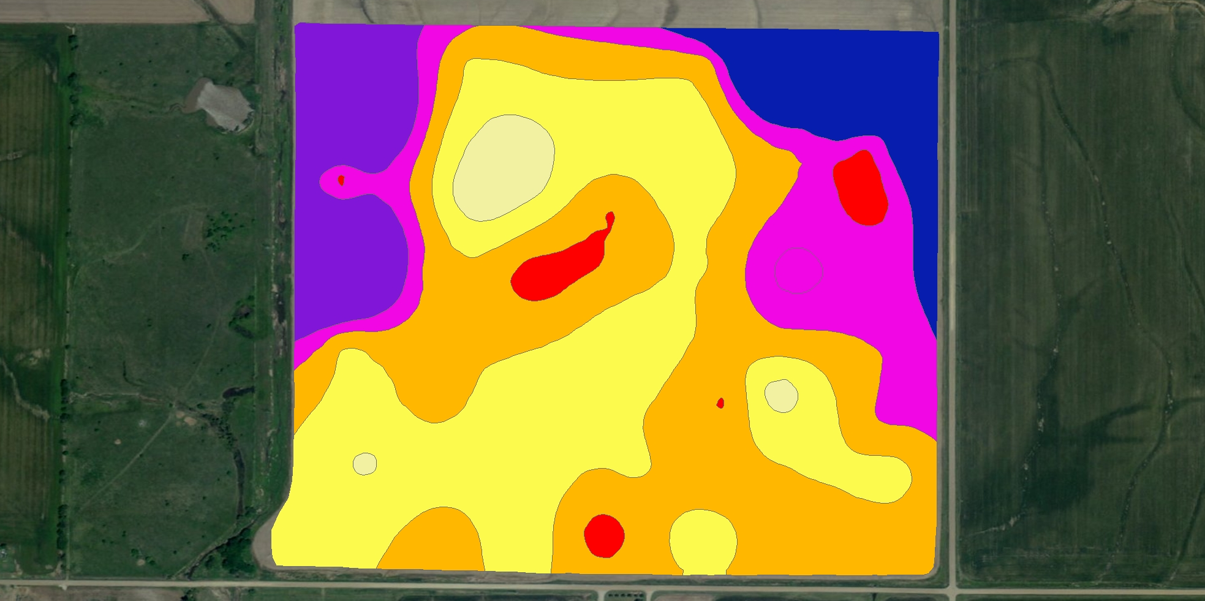
Soil Test P, Ponca City

Slide 11
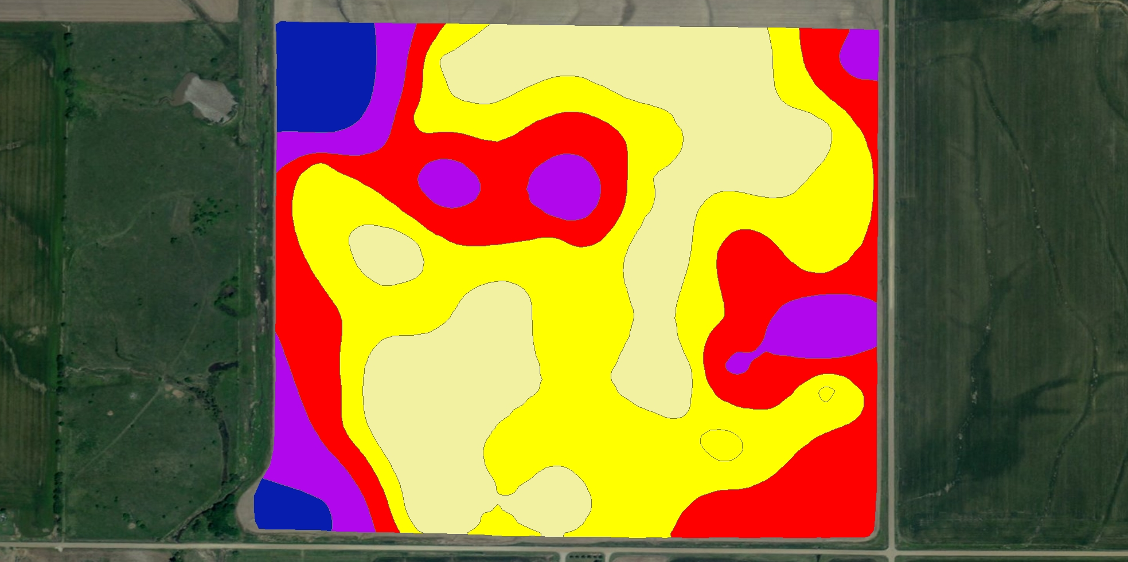
pH, Ponca City

Slide 13
Small Things Add Up
Poor correlation with single variable versus yield.
What does this mean?
If you correct a single problem it probably will result in little effect on yield.

Slide 15
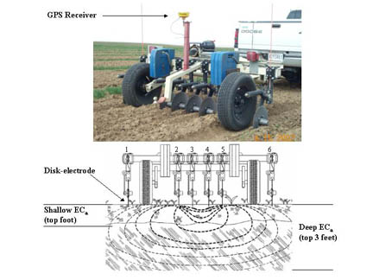
Other Precision Ag technologies and Soil Assessment
Electrical Conductivity

Slide 16
Electrical Conductivity
EC is related to soil texture
Will be influenced by moisture content and will therefore changed over time.
Will of course be influenced by Salinity
However, patterns should be consistent.
Can sometimes be related to productivity and/or other soil characteristics such as nutrition or pH.
For better or worse is often used to identify zones for sampling.

Slide 17
Other on the go sensors
pH, Organic Matter,
http://www.veristech.com/products/visnirfaq.aspx

Slide 18
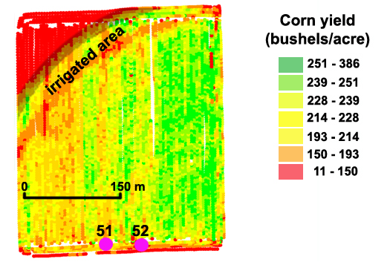
Variable Rate N Applications
Important to correct both Spatial and temporal variability
Spatial variability may be dealt with using historic yield maps
Sensors can be
used to address
spatial and
temporal variability
Apply N where
and when needed.

Slide 19
Variable Rate N Applications
Historically water quality concerns were addressed by decreasing average annual N rates
If not done properly this can reduce yield
Variable rate N applications may not decrease the average N rate but will decrease residual N because N utilization is improved
AKA efficiency is increases, which decreases potential for off-site transport

Slide 20
Use of Sensor Based N Management in Manured Systems
Sensors have been very much under utilized for manure N management
There is a lot of potential for improving manure N management
Manure N availability is highly variable do to a variety of factors
Manure type and characteristics
Soil type, moisture, and temperature
Application timing and methods
Crop type (winter vs summer)

Slide 21
Nitrogen Management in Manured System
Variability in N availability has spawned a great volume of research devoted to evaluating N mineralization and crop uptake.
Despite this effort producers have difficulty dealing with uncertainty about N availably as well as the distribution of available N in the field

Slide 22
Common Methods to Address Variability
Apply manure at rates that are in excess of crop N need.
Continuous annual application at N based rates
These solutions have generally been halted by P based nutrient management planning
Apply supplemental N sufficient to overcome variability (apply N sufficient to optimize yield on most N deficient area of the manure field

Slide 23
Example of Research on Poultry litter N Availability
Poultry litter was pre-plant applied for corn production on the Eastern Shore of VA.
N Source | Total N applied | 2002 | 2003
 | lbs acre⁻¹ | -------bu acre⁻¹-----
Peanut Hulls | 125 | 101 | 104
Woodshavings | 125 | 93 | 115
Sawdust (alum) | 125 | 96 | 116
Sawdust | 125 | 97 | 113
Pelletized | 125 | 89 | 120
LSD(p<0.1)= |  | 20 | 15

Slide 24
N Response Curve
Poultry litter N utilization ranged from 40-56%
160
2002
140
2003
120
Corn Yield (bu acre⁻¹)
100
80
56%
2002 Litter
60
40%
2003 Litter
40
0
50
100
150
200
250
Inorganic N Fertilizer Rate (lbs acre-1)

Slide 25
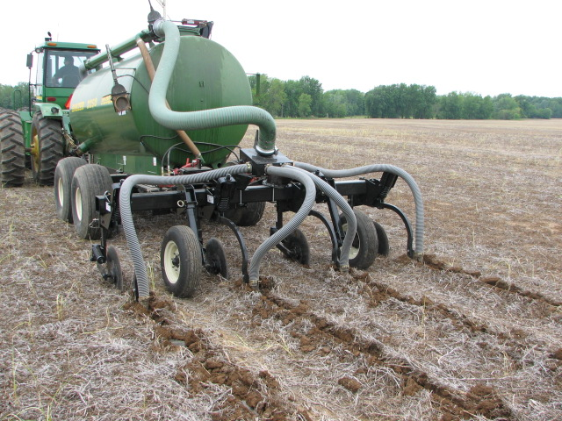
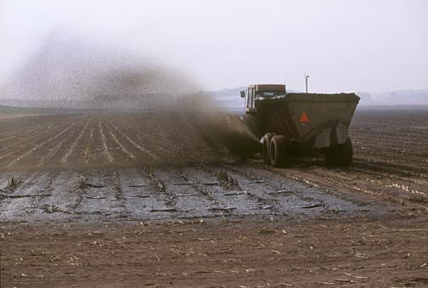
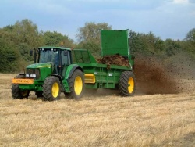
In-Field Variability after Manure Applications
Uniform application of manure is difficult to achieve
This will of course cause non uniformity in crop response.
Must be over come by applying based on the need of most deficient areas.

Slide 26
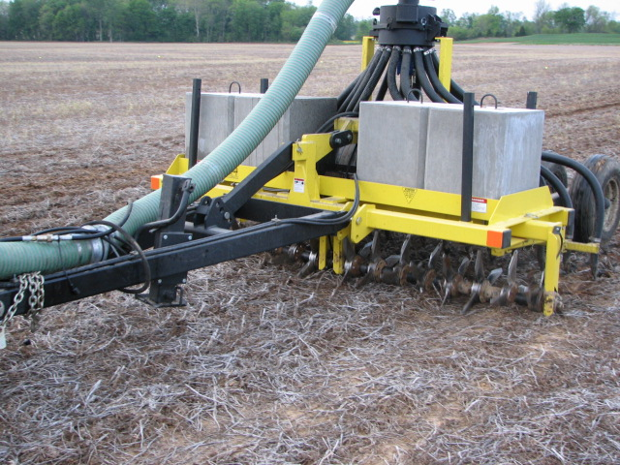
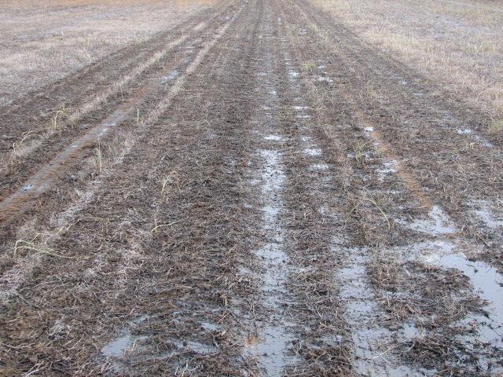
Evaluation of Swine Effluent Application Methods
Study was conducted in Central, KY to evaluate the impact of swine effluent application method on no-till corn yields
Aeration
Injection
Surface Application

Slide 27
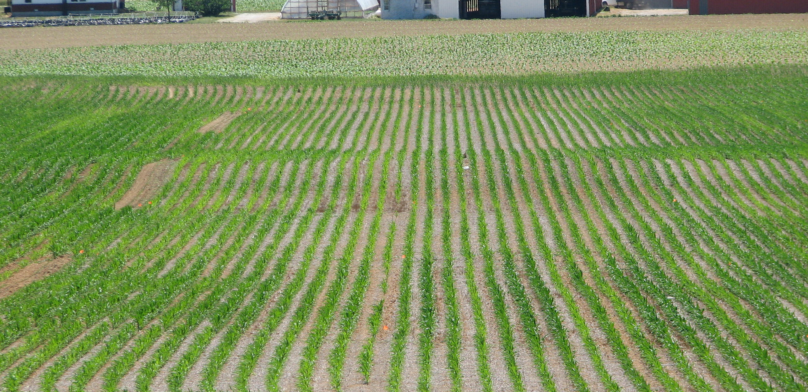
Spatial Variability In Crop Response Resulting from Application Methods
Sidedress in 2007
Green seeker was used to measure NDVI and provide row yield estimates
Surface
Control
Aerway
Row 7=210 bu/acre
Row 8=157 bu/acre
Fertilizer
Injector

Slide 28
Actual Corn Yields and Estimated Variability
UAN fertilizer provided lowest variability
Injector optimized yield but maximized between row variation
Surface application had less than optimum yield due to ammonia loss and increased variability
Aeration increased drought stress.
N Source | Total N Applied | Yield | Coefficient of Variation
 |  |  | Within Row | Between Row
 |  | bu acre⁻¹ | ---------------%---------------
Check | 0 | 161 | 23 | 4
UAN | 160 | 170 | 20 | 4
Surface | 160 | 159 | 23 | 8
Injector | 160 | 188 | 20 | 8
Airway | 160 | 150 | 25 | 7

Slide 29
Do Manure Applications Impact Sensor Recommendations for Wheat
Comparison of predicted vs actual wheat yields resulting from pre-plant applications of litter and fertilizer showed that litter use did not influence yield prediction on the Eastern Shore, VA

Slide 30
Sensor Based Top-dress N Applications Pre-plant Litter
In 2003 yields were similar, however in 2004 litter produced lower yields due to early season N deficiency
Topdress applications did not overcome early season deficiency
-------Treatments†------ |  | 2003 |  | 2004
PP | GS 30 | N Rate | Yield | N rate | Yield
 |  | kg ha⁻¹ | Mg ha⁻¹ | kg ha⁻¹ | Mg ha⁻¹
CHECK | NONE | 0 | 2.6 | 0 | 4.0
Litter | VR | 48-119 | 5.1 | 18-71 | 5.9
Fertilizer | VR | 36-122 | 4.7 | 14-59 | 6.7
lsd (p<0.05) |  |  | 0.8 |  | 1.6

Slide 31
Sensor-based Technology is a Must for Continued Improvement in Manure N Management
Simply using an N rich strip can take the guess work out of estimating whole field N availability
Provides potential to correct in-field variability with high precision applications (ie, by plant or by row)
Current methods used to estimate crop N status appear to be sufficient

